Slide 1
15th Poweron Technical Conference Energy Storage, E- mobility 16th Jan 2020, Indore, Madya pradesh Can Lithium outsmart Lead ( or is it a fear mongering)
Dr. Nanjan Sugumaran, Ph.D ( I.I.Sc)

Slide 2
21st Century – Era of Decentralised energy
Decentralized | Energy Generation | Maximum Efficiency
 | Energy Storage
 | Energy Utilisation

Slide 3
Energy Storage Options
Energy Storage
Chemical Energy
1) Hydrogen
2) Synthetic Natural Gas
3) Chemical compounds ( Methanol, Ammonia)
Mechanical Energy
1) Pumped Hydro
2) Compressed Air
3) Fly wheel
Electrical/Electrochemical
1) Super capacitors (EDL/ Pseudo)
2) Super conducting magnets
3) Batteries
4) Fuel Cells
Thermal Energy
1) Hot water
2) Molten Salt
3) Phase- Change material

Slide 4
Electrochemical /Electrical Energy Storage Options
1 | Energy can be stored from mili Ah to Mega Ah ( to electrify the village)
2 | Energy efficiency is > 85 % . Coulombic efficiency is 95% to 99.9%
3 | Recyclable and hence less stress on natural resource
4 | Response time is in mS
5 | Life is > 15 years
6 | Rechargeable in nature and for recharging solar energy can be used. Hence we can recharge anywhere
7 | De-centralised power system hence no transmission loss
8 | Less pollution
9 | Minimum global warming
10 | Affordable

Slide 5
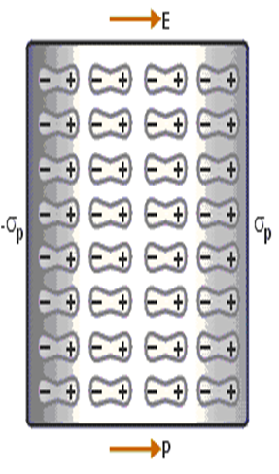
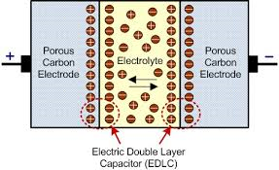
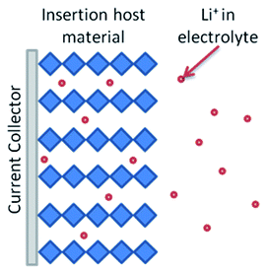
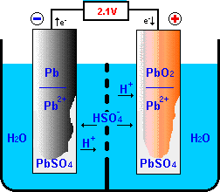
Electrochemical/Electrical energy storage options
Capacitor
EDLC
Pseudo capacitor
Batteries

Slide 6
Types of Batteries used for Energy storage/E-mobility
 | Type | Nominal Voltage
Lead Based | Lead –Acid | 2.0 – 2.1
Nickel based | Nickel – Cadmium | 1.2
 | Nickel - MH | 1.2
Lithium Based | Oxide Based | 3.6 – 3.8
 | Spinel based | 4.4-4.5
 | Phosphate based | 3.2
Flow Battery | Zn- Br | 1.8
 | Vanadium redox flow | 1.15 – 1.55
High temperature | Na – S | 3.7
 | Na – Nicl2 | 3.8
Metal Air | Zn – air | 1.5
 | Al - air | 1.2
Fuel cell | H2-O2 | 0.6 – 0.7

Slide 7
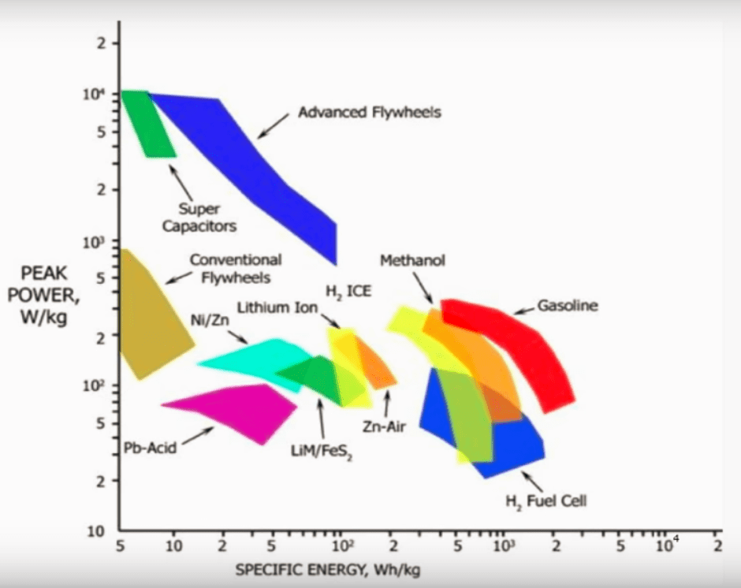
Lithium – Why sudden craze - Energy vs power
Lithium ion is valid only for
Present design

Slide 8
Lithium – why sudden craze ( Highly priced/ Well marketed)
1 | Stating from 1990 , Lithium is the undisputable king in Camera, Mobile phones and Laptops because of high energy density and low energy content.
2 | Success rate is very high in the above applications due to less energy in the system
 | Energy Content | V | Ah | Wh | Battery configuration
 | Canon Camera | 7.4 | 1.39 | 10.286
 | I phone X | 3.81 | 2.716 | 10.35
 | Dell computer | 10.8 | 4.05 | 43.74
 | MAC Book | 7.3 | 5.34 | 39
3 | The batteries are variants of oxide system ( LCO/NCM) so that SOC monitoring is accurate and it is customer friendly
4 | At maximum there are three cells in series, so that monitoring is very easy. BMS is easy
5 | The thermal phenomena can be taken care by small air fan which is built in to system. Thermal management is easy
3.7/1.39
3.7/1.39
3.81/2.716
3.6/4.05
3.6/4.05
3.6/4.05
3.65/5.34
3.65/5.34

Slide 9
Lithium – why sudden craze
1 | The sudden success in lower energy content product gave an impetus to go in to EV, which is need of the hour due to global warming and pollution
2 | Most Countries economy and growth depends on conventional fuel such as diesel, petrol and gas. They wanted to reduce their overdependence on this. India is classic example.
3 | Developed countries wanted their economy and growth should depend on clean fuel and wanted to reduce green house gases emission to environment
4 | Lead Acid battery, ignorantly, became enemy of policy makers and NGO because of its name Lead and Acid in spite of 99% recyclability

Slide 10
EV - Evolution - Lithium glorification – Rewarding the Failure
Pure Electric Vehicle
USA/Europe/ Japan (1992)
(20-100 KWH)
4 Wheeler EV to replace ICE (Lithium Based)
China (2000)
1 KWH
2 Wheeler EV for intra town travel (VRLA)
India/ Bangladesh/ Nepal (2010)
1 – 6 KWH
3 Wheeler EV for regular commutation and last mile connectivity (Lead Acid Flooded)

Slide 11
2/3 wheeler Energy requirement
 | Manufacturer | Energy KWH | Battery Chemistry | Single cell | Mono bloc | No. of mono blocs | Battery Spec | No.of cells
1 | China - E bike | 1 KWH at C2 | VRLA | 2V/ 20Ah | 12V/ 20Ah (6S) | 4 | 48V/ 20Ah | 24
2 | India / Bangladesh E rickshaw | 3.5 KWH at C3 | Lead Acid Flooded Flat | 2V/ 100Ah | 12V/ 100Ah (6S) | 4 | 48V/ 100Ah | 24
3 | India - E rickshaw | 3.5 KWH at C3 | Lead Acid Flooded Tubular | 2V/ 100Ah | 12V/ 100Ah (6S) | 4 | 48V/ 100Ah | 24
4 | Bangladesh E rickshaw | 6 KWH at C3 | Lead Acid Flooded Tubular | 2V/ 140Ah | 12V/ 140Ah (6S) | 5 | 60V/ 140Ah | 30

Slide 12
2/3 wheeler status - Success story with Lead/Acid
1 | No. of 2 wheeler E-Bike in China with VRLA | 250 Million
2 | No. of 3 wheeler E- Rickshaw in India with Flooded Lead/Acid | 1.5 Million ( growing at 10% rate per annum)
3 | No. of 3 Wheeler E- Rickshaw in Bangladesh with Flooded Lead/Acid | 0.8 Million
 | Total money spent on research | Nil or Miniscule
In spite of great success, it has no father to claim for the success

Slide 13
Reasons for low energy EV success in China, India and Bangladesh - Social and Economic impact
 |  | China – 2 wheeler | India – 3 wheeler | Bangladesh – 3 wheeler
1 | Battery Technology | VRLA | Lead acid - Flooded | Lead acid – Flooded
2 | Cheap | Y | Y | Y
3 | Solid manufacturing base/ Cottage industry | Y | Y | Y
4 | Technology robust and proven | Y | Y | Y
5 | Energy content | 1 KWH | 3.5 KWH | 6 KWH
6 | Used for Intra town travel | Y
7 | Used for last mile connectivity |  | Y | Y
8 | Frequent start/stop |  | Y | Y
8 | Used for regular commutation |  |  | Y
9 | Upgrading labour dignity |  | Y | Y
10 | Safe | Y | Y | Y
11 | Recyclable | Y | Y | Y
12 | Impact on pollution | Reduced | Reduced | Reduced

Slide 14
4 Wheeler status - Yet to become commodity
 |  |  | Tesla - S | BMW – i3 | Nissan - Leaf | Mercedes
1 | Energy Of Battery pack | KWh | 70 | 38 | 30 | 28
2 | Battery Specification | V/Ah | 345/236 | 355/120 | 350/112 | 302/110
3 | Battery Chemistry |  | NCA/C | NMC/C | LMO/C NMC/C | NCA/C NMC/C
4 | Single cell configuration |  | Cylindrical | Prismatic | Pouch | Cylindrical
5 | Single cell specification | V/Ah | 3.6/3.2 | 3.7/120 | 3.65/56.3 | 3.6/2.5
6 | Single Module configuration | S/P (No.s) | 6/74 (444) | 12/1 (12) | 4/2 (8) | 7/44 (308)
7 | Single cell module specification | V/Ah | 21.6/236.8 | 44.4/120 | 14.6/ 112.6 | 25.2/110
8 | Energy/Module | KWH | 5.114 | 5.328 | 1.644 | 2.772
9 | No. of Modules | No.s | 16 | 8 | 24 | 12
10 | No. of Cells | No.s | 7104 | 96 | 192 | 3696

Slide 15
EV – 4 Wheeler – global statistics ( Jan 2019)
5.1 Million vehicle on the road, which is 0.4% of total vehicle population
2.24 Million vehicle on the road, which is 0.94% of total vehicle in China

Slide 16
4 Wheeler status - Cell to Battery ( 345V/236Ah)
Evolution
Cell | 3.6 V/ 3.2 Ah - Cylindrical
Module (21.6V/236.8Ah) | 1) Cell grouping to be done based on OCV and IR
 | 2) 444 cells to be arranged as 6 in series and 74 in parallel
 | 3) 888 weld joints to made ( Quality can not be assured)
 | 4) BMS is the real technology in Lithium Battery
 | Cells in group | BMS system | Cells in group | BMS system
 | 1 | 444 | 6 | 74
 | 2 | 222 | 12 | 37
 | 3 | 148
 | 5) Controller to balance the cells
 | 6) Thermal management system ( air or liquid)
Pack | 1) 16 modules to be connected in series
 | 2) Inter module connector has to withstand 74 times of inter cell connector current
Cell
Module
Pack

Slide 17
Challenges in High energy Lithium Battery
1 | In cylindrical configuration the no. of cells per module are very high. Hence it needs very sophisticated BMS. Monitoring of individual cell in the battery pack is cost prohibitive and needs high tech electronics
2 | Modules are getting monitored assuming the cells within the modules behave identically. It needs high quality sophistication during manufacturing. Individual cells voltage and IR are getting monitored, segregated and assembled. The system is not fool proof and also leads to huge loss in First Time Pass
3 | More no. of cells need more spot welding and more robotics and automation needed
4 | In higher Ah cells, the inter cell connector needs to pass very high current which will result in thermal problem
5 | If there is any defect in one module/cell, replacement cost is very high in higher Ah design
6 | Hence Battery management system and Thermal management system are very critical apart from sophisticated manufacturing of lithium cells
7 | All the above factor leading to increase in cost which a customer who has enjoyed ICE may not willing to pay

Slide 18
Chemistry of Lithium ion Battery - Variants
Positive electrode | Negative electrode
LiCoO2 | C6
Li Ni0.33 Mn0.33 Co0.33 O2 | Li4Ti5O12
Li Ni0.80 Mn0.10 Co0.10 O2 | Li0.79Si0.21
Li Mn2O4 | Li
Li Ni 0.5 Mn 1.5 O4
Li Fe PO4

Slide 19
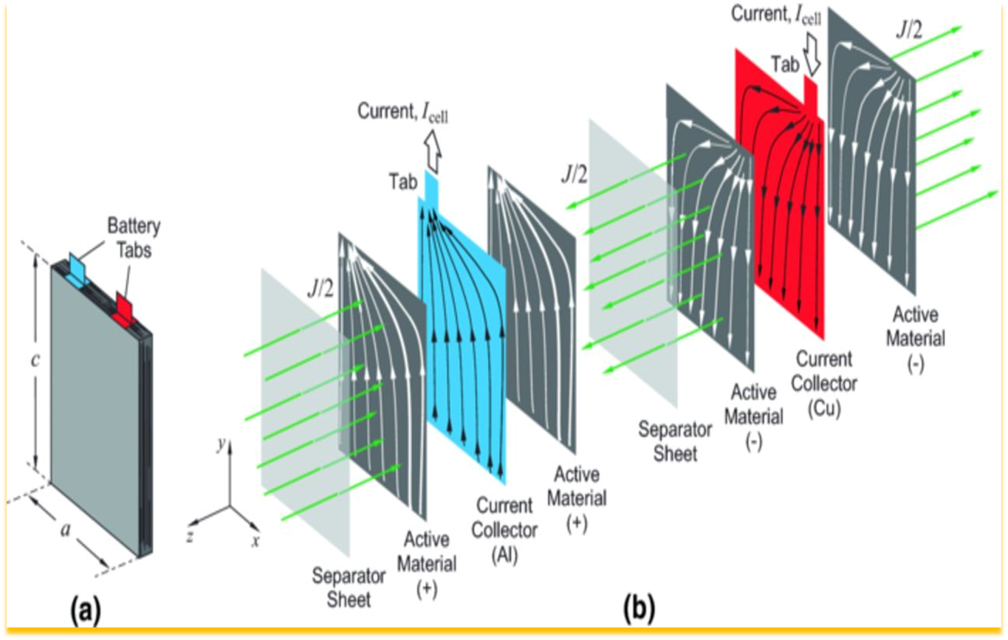
LITHIUM Battery Autopsy

Slide 20
LITHIUM Battery vs Lead Acid Construction comparison
 |  | Lead Acid | Lithium ion
Negative active material thickness | micron | 1400 | 65
Negative electrode thickness | micron | 1000 | 10
Negative active material thickness | micron |  | 65
Separator thickness | micron | 250/750 | 20
Positive active material thickness | micron | 1600 | 55
Positive electrode thickness | micron | 1200 | 15
Positive active material thickness | micron |  | 55
Total active block thickness | micron | 4000 | 285
Because of very low thickness, Lithium ion is able to provide higher energy and higher power compared to other system. Once the thickness increased then for given power more active material to be stuffed into system

Slide 21
Impact of thickness on Capacity (NMC electrode)
JECS, 162 (7) A 1196- A1201 (2015)

Slide 22
Impact of thickness on Capacity (NMC electrode)
1 | The coulombic efficiency of Lithium battery is more than 99.5% is due to low active material thickness ( 50 micron)
2 | Increase in thickness beyond 50 micron resulting in decreasing coulombic efficiency and also life under operating discharge ( more than C/3 rate)
3 | Diffusion of Lithium ion inside active material is major problem
4 | Heat generation due to IR is another problem
5 | Manufacturing higher Ah single cell in cylindrical configuration is a major issue. Hence maximum Ah till now is 7Ah
6 | In prismatic version a single cell of 110Ah available. The impact of heat under high rate discharge will be an issue
7 | In field, lithium battery needs more no. of cells to be assembled in parallel and in series. More the no. of cells, more the probability of failure
8 | Thermal management is another important factor to be considered with Lithium

Slide 23
Challenge from Chemistry - Half cell reactions in Lithium ion Batteries
Positive electrode | Negative electrode
Li MO2 Li (1-x) MO2 + x Li + + x e- | C6 +x Li (+) + x e (-) Lix C6
LiMn2O4 Li (1-x) Mn2O4 + x Li (+) + x e (-)
 | Li4Ti5O12 + 3Li(+)+ 3 e(-) Li7 Ti5 O12
Li Fe PO4 Fe PO4 + Li (+) + e (-)

Slide 24
Lithium Cobalt Oxide Battery – working principle
 | Discharged state Li MO2 |  |  |  |  | Charged state Li(1-x)MO2 |  |  |  |  | X varies from 0.5 to 1
Cobalt ( 27) 3 d7 4 s2 | Co - 3+ state ( d6) |  |  |  |  | Co - 4+ state (d5)
 | Eg |  |  |  |  | Eg |  |  |  |  | Charged state is less stable
 | T2g | ** | ** |  | ** | T2g | ** | ** |  | *
Nickel ( 28) 3 d8 4 s2 | Ni – 3+ state (d7) |  |  |  |  | Ni – 4+ state (d6) |  |  |  |  | Charged state is more stable. Self passivation is the main problem
 | Eg | * |  |  |  | Eg
 | T2g | ** | ** |  | ** | T2g | ** | ** |  | **
Manganese (25) 3 d5 4s2 | Mn – 3+ state (d4) |  |  |  |  | Mn – 4+ stae (d3) |  |  |  |  | Charged state is more stable
 | Eg | * |  |  |  | Eg
 | T2g | * | * |  | * | T2g | * | * |  | *

Slide 25
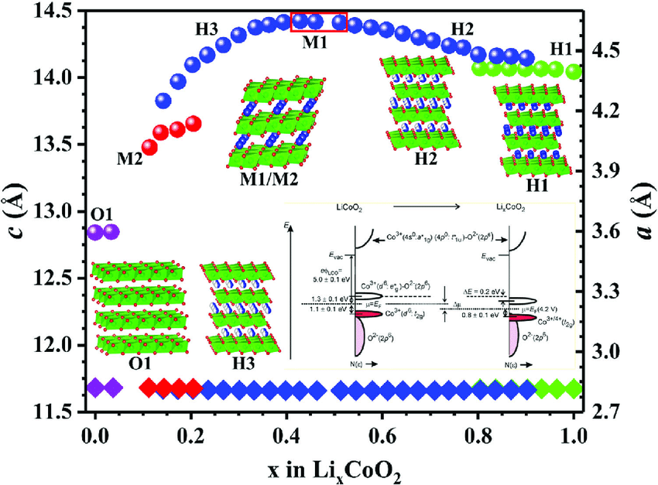
Lithium CoO2 Battery – change in active material
Structural change is taking
place in electrode and no
Stable chemical species formed
during the change

Slide 26
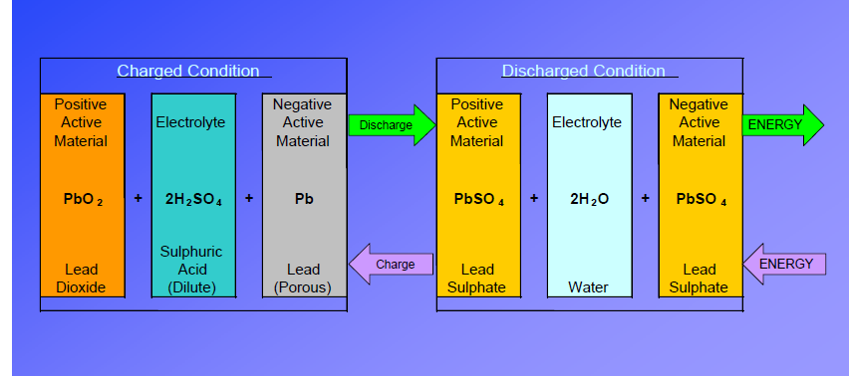
Chemistry of Lead acid Battery
Charged and discharged materials are stable chemical compounds

Slide 27
4 Wheeler Lithium EV - Is this a concept or a Commodity
1 | Not able to compete with ICE even after billions of Dollar research though battery pack price fallen from 663 USD/KWH (2013) to 156 USD/KWH (2019)
2 | Range is another issue
3 | Safety is another major issue. Can it work in a Tropical climate
4 | Battery manufacturing is too sophisticated process. FTT is around 90% and testing of cell can be done after 30 days. Capital cost and inventory cost is very high. This is going towards centralised manufacturing
5 | Each module involves hundreds of cells and impossible to expect all cells behaves in identical manner
6 | Module assembly involves thousands of weld joints, which can not be tested for their quality
7 | BMS is another pain in the neck. All the cells can not be monitored and only group of cells in a module can be monitored. Removing group of defective cells from module is a challenging task
8 | Thermal management is another major hurdle
9 | There is no consensus among battery manufacturer about the type of cell to be used for EV. It varies from NCA, NMC, LMO and LFP. Each needs separate charging protocol
10 | Disposal of end of life Lithium cell is a global problem
11 | Failure in the road is not in PPM range
12 | Seen as rich man’s baby

Slide 28
Lead vs Lithium
Application | Lead | Lithium
Automotive | Lead will dominate | Lithium yet to prove cold temperature and very high rate discharge performance
Telecom | Lead will dominate | LFP/LTO may take some market
Motive power | Lead will dominate | LFP/LTO may take some market
UPS | Lead will be there | LFP/LTO may take some market
Mobiles/Lap top |  | Lithium is the King
E-rickshaw/ E-bike | Increase in life is must and do or die for Lead | Good chance for Lithium
EV |  | Lithium is yet to be established as a commodity

Slide 29
Improvement in Lead acid Battery
No.s | Area | Research Focus
1 | Alloy quality | Oxygen entrapping in alloy to be avoided mainly in calcium and low antimony system. Oxygen scavengers to be removed from alloy
2 | Ultrapure lead | Already doubled the life of battery
3 | Oxide | Nano particle oxide to improve efficiency
4 | Additives in positive paste | A/C from BDS is altering grid/active material adhesion, which will prevent corrosion of grid
5 | Additive in negative paste | dCNT which is well known for suppressing sulphation and increasing life to be tried
6 | Formation | Appropriate method to generate PAM of sufficient strength to be evolved
7 | Separator | Optimising web, overall thickness and rib profile for enhancing the life of battery
8 | Charging | CF optimisation for various applications

Slide 30
Conclusions
1 | New civilization will emerge in 21st century based on technology
2 | Decentralized energy will be ubiquitous
3 | Battery will be a part and parcel of human life
4 | Lithium will dominate in low energy requirement
5 | Lead will be undisputable king in higher energy application areas
6 | LFP/LTO may sustain among lithium variant
7 | Lead and Lithium will coexist in several areas
8 | New hydrogen fuel cell may emerge
9 | Lead has to improve especially in low energy EV ( E-bike and E-rickshaw). Lithium has to reduce its cost. The fight is in this segment. Even with 30% more cost Lead can outsmart Lithium provided Lead guys comes out of Coma

